Slide 1
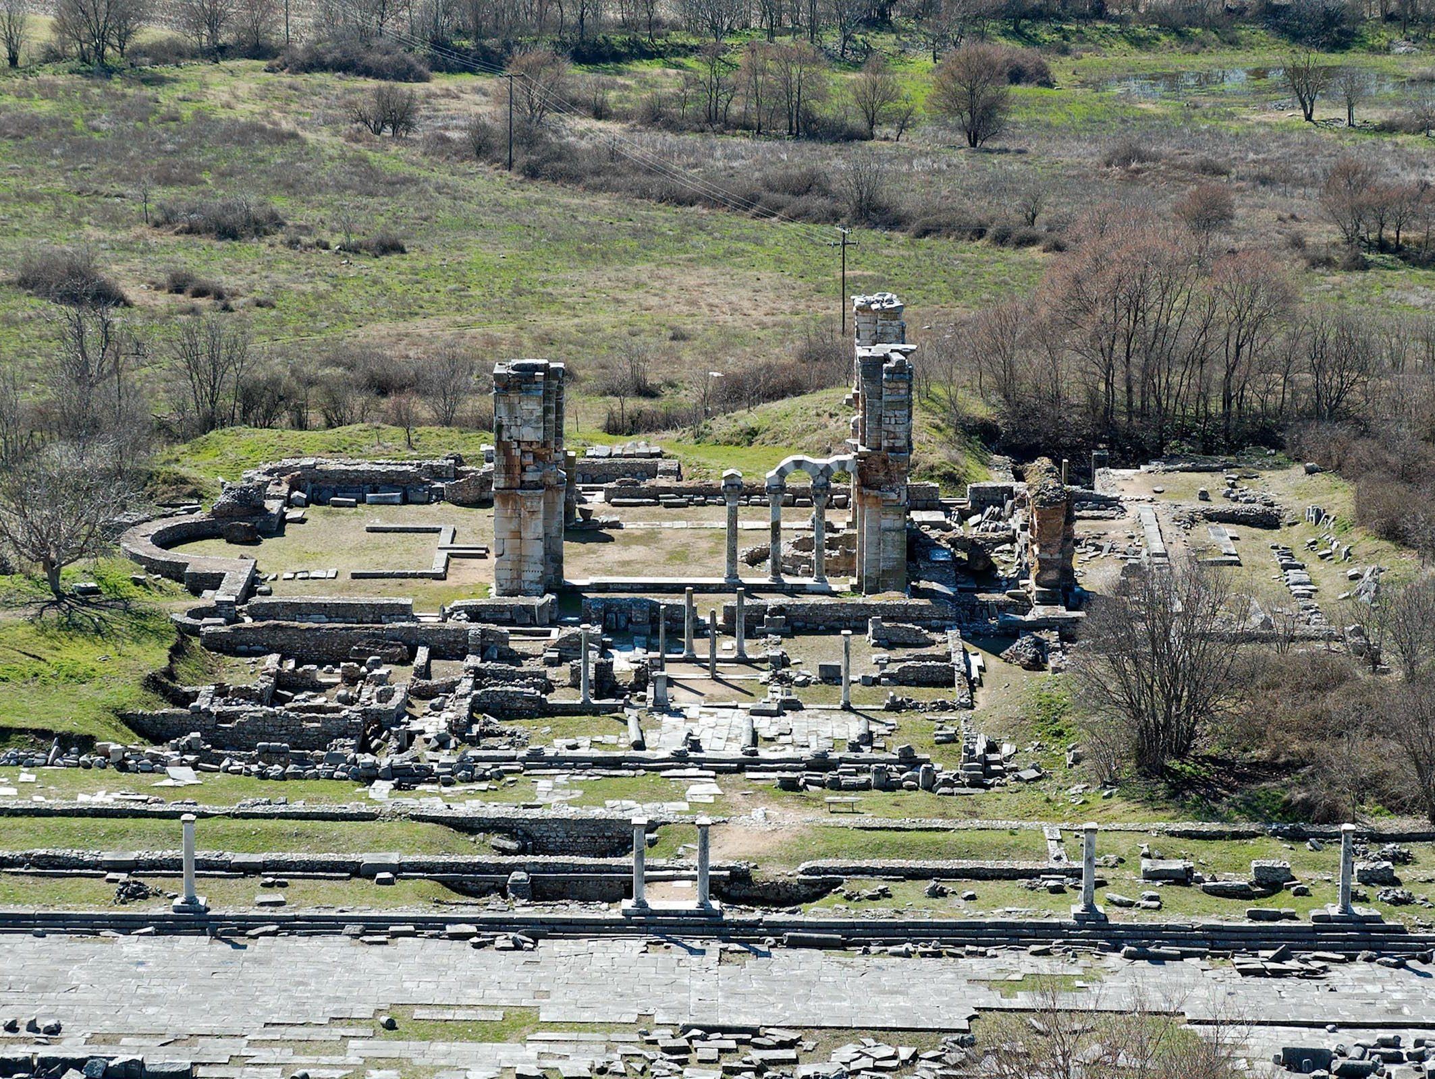
Philippians 2.19-30
Remains of market area and church in Philippi
image ©2012 Todd Bolen / BiblePlaces.com

Slide 2
Philippians 2.19 NET: Now I hope in the Lord Jesus to send Timothy to you soon, so that I too may be encouraged by hearing news about you.

Slide 3
Philippians 2.20-21 NET: For there is no one here like him who will readily demonstrate his deep concern for you. Others are busy with their own concerns, not those of Jesus Christ.

Slide 4
Philippians 2.22-24 NET: But you know his qualifications, that like a son working with his father, he served with me in advancing the gospel. So I hope to send him as soon as I know more about my situation, though I am confident in the Lord that I too will be coming to see you soon.

Slide 5
Philippians 2.25 NET: But for now I have considered it necessary to send Epaphroditus to you. For he is my brother, coworker and fellow soldier, and your messenger and minister to me in my need.

Slide 6
Philippians 2.26-30 NET: Indeed, he greatly missed all of you and was distressed because you heard that he had been ill. In fact he became so ill that he nearly died. But God showed mercy to him– and not to him only, but also to me– so that I would not have grief on top of grief. Therefore I am all the more eager to send him, so that when you see him again you can rejoice and I can be free from anxiety. So welcome him in the Lord with great joy, and honor people like him, since it was because of the work of Christ that he almost died. He risked his life so that he could make up for your inability to serve me.

Slide 7

Perfection of Christ
Paul [still climbing]
Timothy [still climbing]
Epaphroditus [still climbing]
Spiritual Growth Potential
Ladder © freepik.com
Fleshiness of new believer

Slide 8
Perfection of Christ
Spiritual Growth Potential
maturity
time
Fleshiness of new believer

Slide 9
Perfection of Christ
Spiritual Growth Potential
maturity
serving plateau
pew sitting plateau
time
Fleshiness of new believer

Slide 10
Perfection of Christ
Spiritual Growth Potential
maturity
time
Fleshiness of new believer

Slide 11
Perfection of Christ
Spiritual Growth Potential
maturity
time
Fleshiness of new believer

